Slide 1
Development of T Lymphocytes

Slide 2
Lecture outline
Comparison between BCR and TCR
Describe the coreceptors CD4 and CD8
Mechanisms of T cells diversity
T cell development stages
Positive and negative selection
How do we develop self-tolerance to molecules normally found outside the thymus
Surface molecules of T cells
Homing of T cells

Slide 3
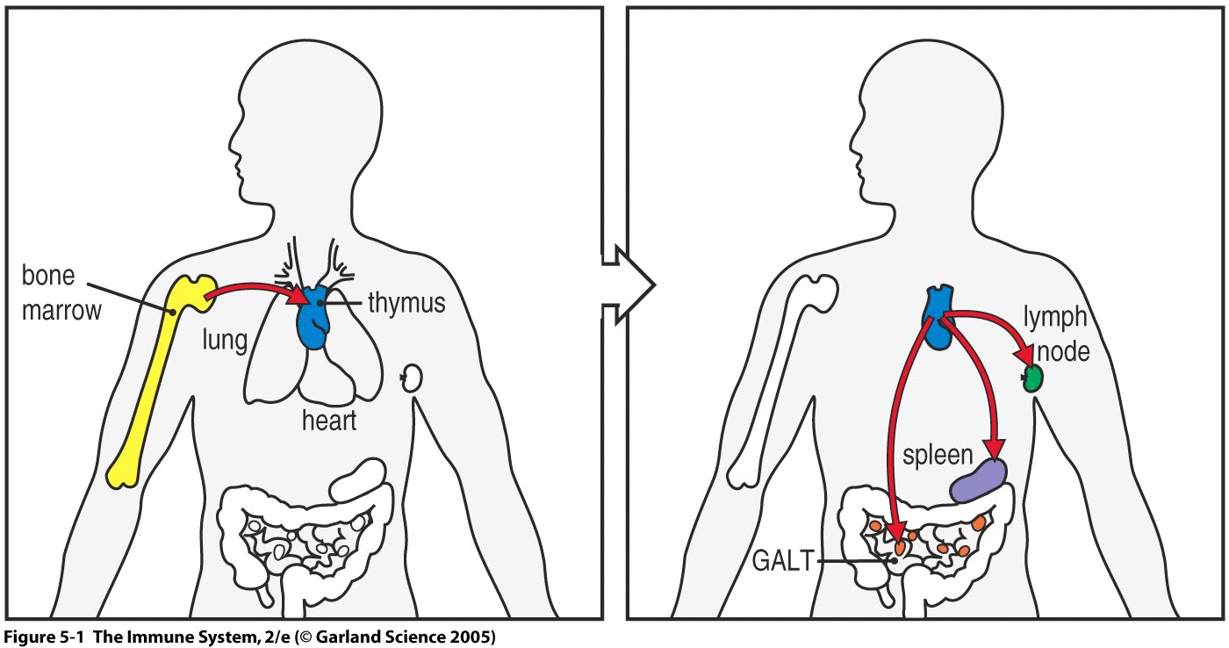

Slide 4
TCR
Like B cells, T cells express an Ag-specific Receptor called TCR. Every clone of T cells expresses a TCR with a unique sequence
Similarities between TCR and BCR
1. Belong to Ig superfamily
2.Comprises 2 disulfide-linked polypeptide chains α and β
3.Transmem glycoprotein with short cytoplasmic tail
comprise V and C regions that folds into an Ig-like domain
4.contain 3 hypervariable regions CDR1, CDR2, CDR3
(CDR3 is the most variable region)

Slide 5
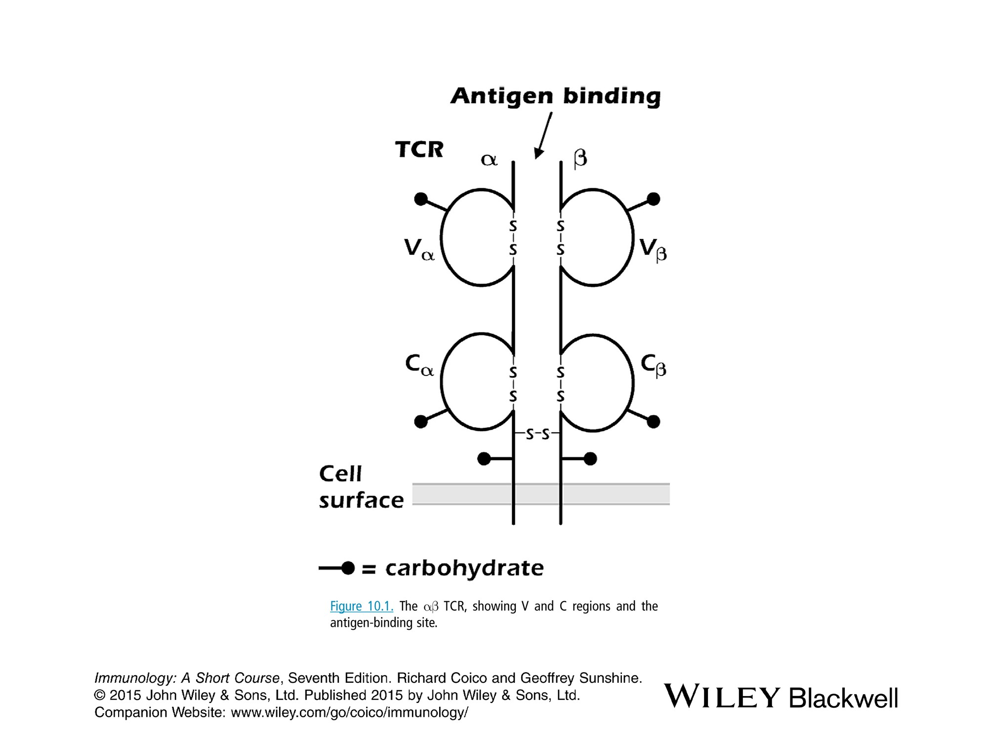

Slide 6
Differences between TCR and BCR
Valence and conformation
TCR is a 2-chains structure with single binding site (monovalent like Fab of BCR). TCR has rigid conformation unlike the 4-chain BCR.
Ig more flexible that allows it to bind bivalently to Ags either at the surface of the B cell or in solution but TCR is appropriate for binding to the surface of other host cells.

Slide 7
2. Ag recognition
BCR recognize different types of Ags (carbohydrates, proteins, DNA and lipids) in fluids and respond to linear and conformational epitopes so both the 3-dimentional structure and the sequence of An Ag are important in eliciting Ab response.
TCR interact with small peptides in association with a MHC expressed on the surface of a host cell

Slide 8
3. Secretion of R
Unlike BCR, TCR does not exist in a secreted form
4. No change in TCR during response to Ags
BCR undergoes somatic hypermutation associated with affinity maturation and class switching to form classes and subclasses at the gene level while TCR does not change during the i.r.

Slide 9
TCR complex
Both chains of TCR are expressed on T cells in noncovalent association with CD3 and 2 identical zeta (ζ) chains.This combination is referred to as TCR comples
Both ζ and CD3 do not bind Ag.
CD3 consist of 3 polypeptide chains each has an Ig-like domain and belong to Ig superfamily
a. Both are signal transduction molecules like Igα and Igβ
b. CD3 plays a chaperone role in transporting the newly synthesized TCR molecule through the cell to the surface.
c. CD3 is invariant on all T cells only (a marker for T cells).
Like Igα and Igβ molecules, CD3 contains the specific sequence referred to as immunoreceptor tyrosine-based activation motif (ITAM)

Slide 10
Coreceptor molecules: CD4 and CD8
Transmembrane molecules on mature T cells called CD4 or CD8 and are specifically expressed on T cells
TC coreceptor does not bind Ag but enhances the ability of Ag to activate T cells or lower the threshold for Ag response
2 populations of T cells exist CD4+ and CD8+ cells
In healthy people, the ratio of CD4 to CD8 is 2:1
Functions:
a. CD4 selectively binds to cells expressing MHC class II molecules while CD8 selectively binds to cells expressing MHC class I molecules
b. Act as adhesion molecules in the interaction between T cell and APC.
c. Signal transduction molecules: the intercellular part of CD4 or CD8 are linked to protein Tyr kinases
d. CD4 act as R to HIV so the cells that have CD4 (T, dendritic, macrophages cell) may be infected by HIV

Slide 11
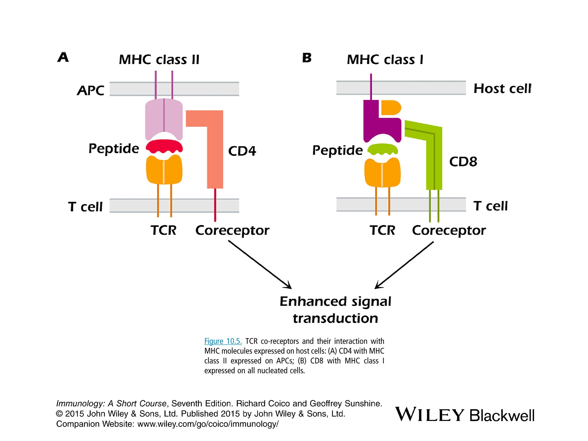

Slide 12
Generation of T cell Receptor Diversity
Genes: Αn α chain is constructed from V (70) and J (60) gene segments like L of Ig while β chain is constructed from V (50), D (2) and J (12) gene segments.
Diversity mechanisms
The same system is involved like B cells (VDJ recombinase and RAG 1 and 2)
a. multiple gene segments
b. somatic DNA random recombination
c. Junctional flexibility
d. Insertional variability
e. interchain combination diversity
Unlike B cells, TCR genes do not undergo somatic hypermutation and class switching following Ag stimulation
TCR β undergoes allelic exclusion but the α chain does not

Slide 13
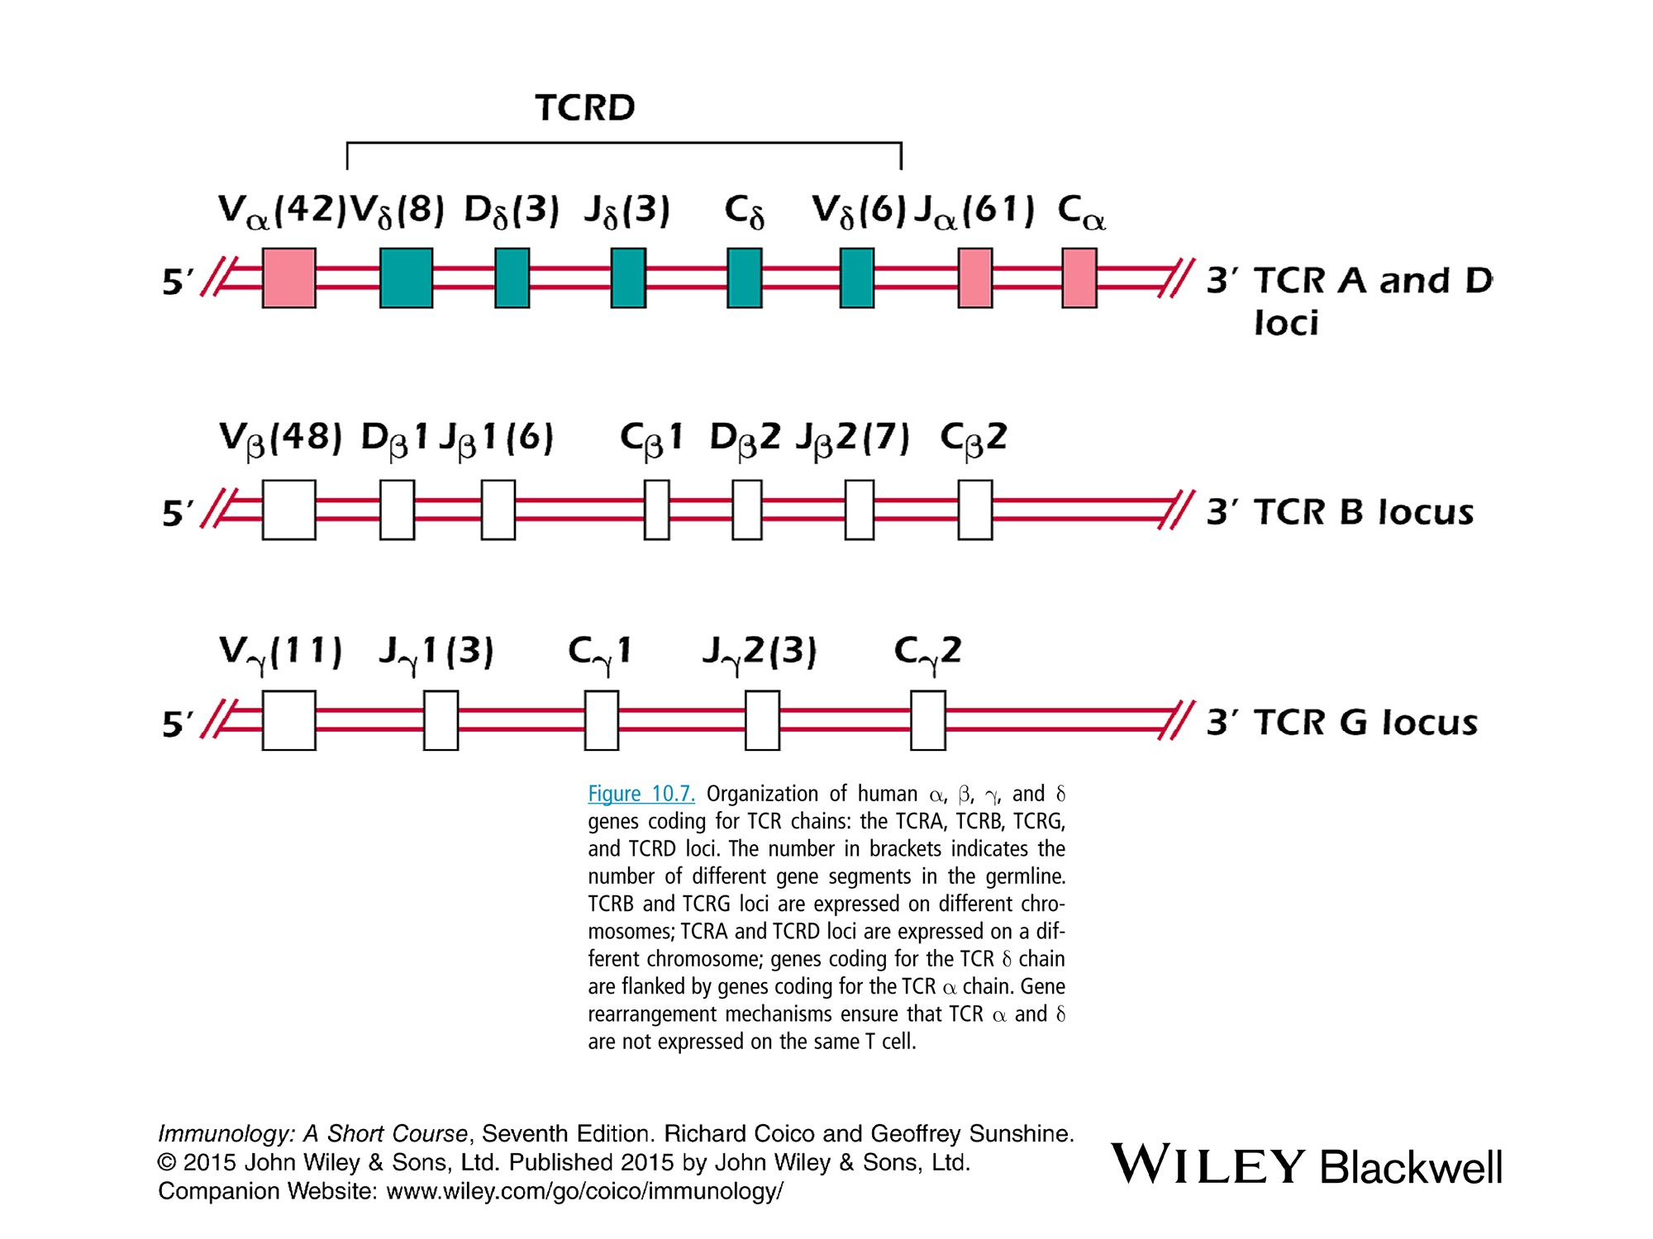

Slide 14
T cell Development
Nude mice (lack of hair) have undeveloped thymus so have no mature T cells
T cell differentiation occurs throughout the life of the individual but diminishes significantly after puberty. The size of the thymus also decreases (thymic involution) due to steroid hormones.
Thymectomized newborn mice: mature T cells drastically depleted
Thymectomized adult mice: has much less impact on T cells

Slide 15
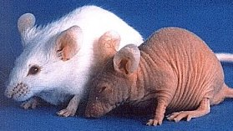

Slide 16
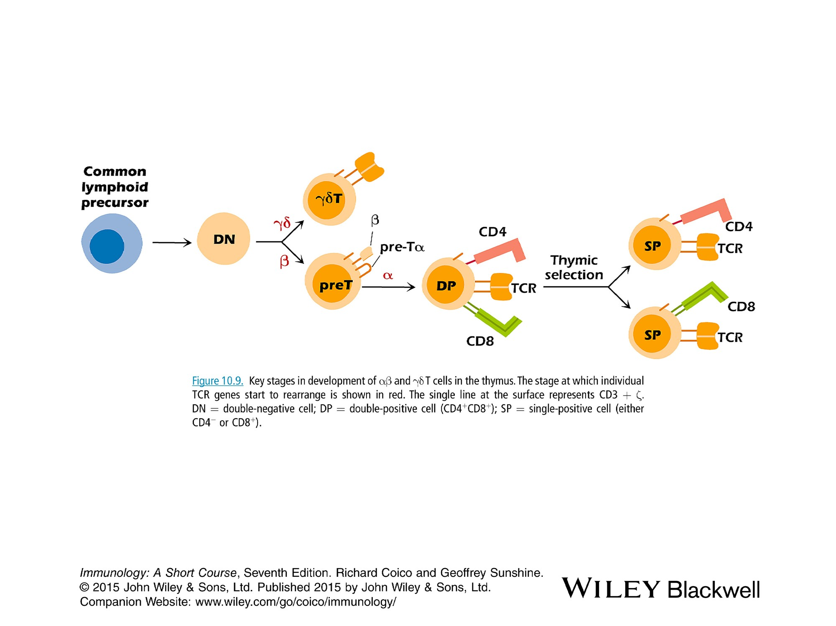

Slide 17
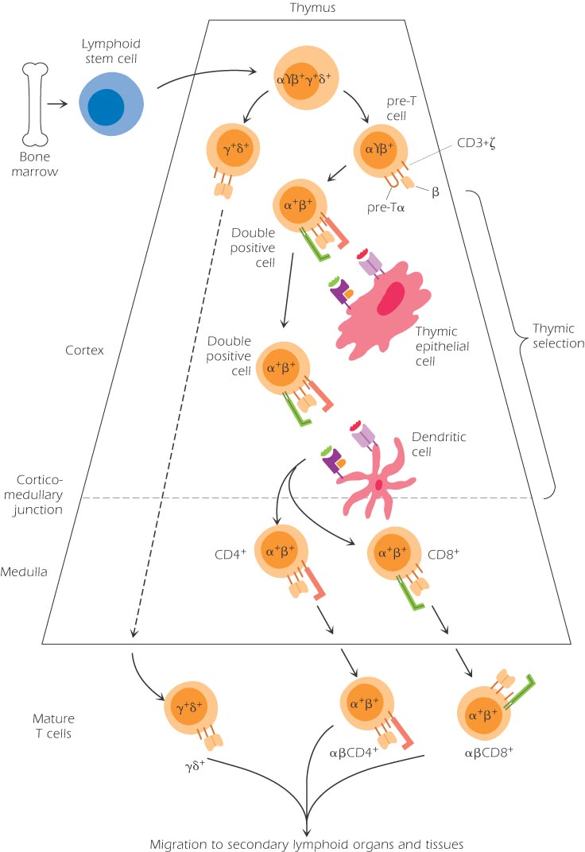
Pre-T cells

Slide 18
Interaction with nonlymphiod cells of the thymus (thymic epithelial and dendritic cells): express class I and II MHC and act as APC
a. Provide critical cell surface interaction required for thymic selection
b. produce IL-7 that induce proliferation and survival of T cell development.
Around 95% of cells dies in the thymus (+ and – selection).
Stem cells migrate from BM to the thymus through blood which are called thymocytes

Slide 19
Pro-T cells
TCR genes of gene β start to rearrange in the cortex. Express no CD4 or CD8 molecules (double negative cell)
The other minor receptor called TCR γδ rearrange first and exit the thymus so they arise early in the development like B-1 cells. What determine the pathway is not well understood.
The majority of cells carry α β TCR

Slide 20
Pre- T cells
Express the TCR β chain in association with an invariant molecule Pre-Tα. The combination with CD3 makes the Pre-TCR analogous to the pre-BCR.
Shows allelic exclusion of β chain only but α genes do not show allelic exclusion so rearrangement of genes may occur on both chromosomes.

Slide 21
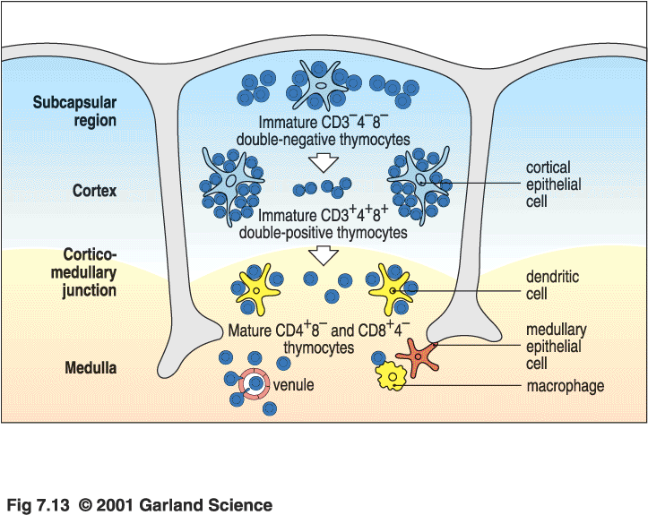

Slide 22
Immature double positive T Cells
Expression of CD4 and CD8 forming the double positive thymocytes cells
Expression of TCR αβ with CD3
Comprise the biggest population of thymocytes (over 80%) in the young thymus.
Found in the cortex but not in the medulla
Undergo the critical process ‘thymic selection”

Slide 23
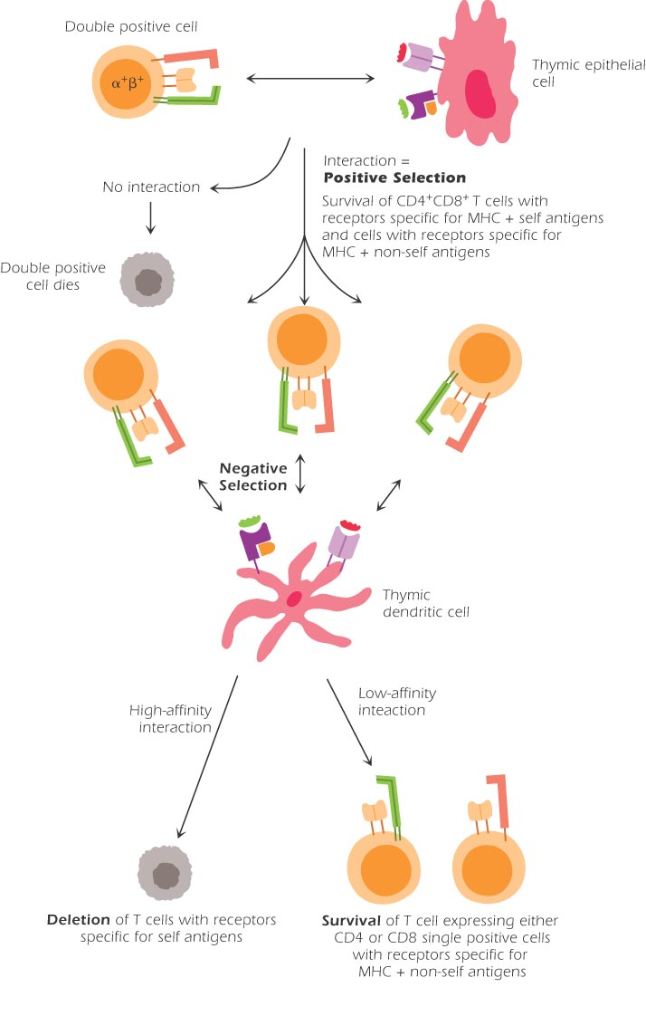

Slide 24
Thymic selection
Comprise 2 major stages: positive and negative selection
Positive selection:
- Double positive (DP) cells interact with self-MHC I & II (expressed by thymic epithelial cells in the cortex) and self-peptide molecules. This interaction results in the survival of the DP cell. The affinity determines the outcome
-A DP cell that does not make this interaction dies by apoptosis
This explains that around 95% of dp cells die in the thymus
-Down regulation of RAG 1&2 gene expression

Slide 25
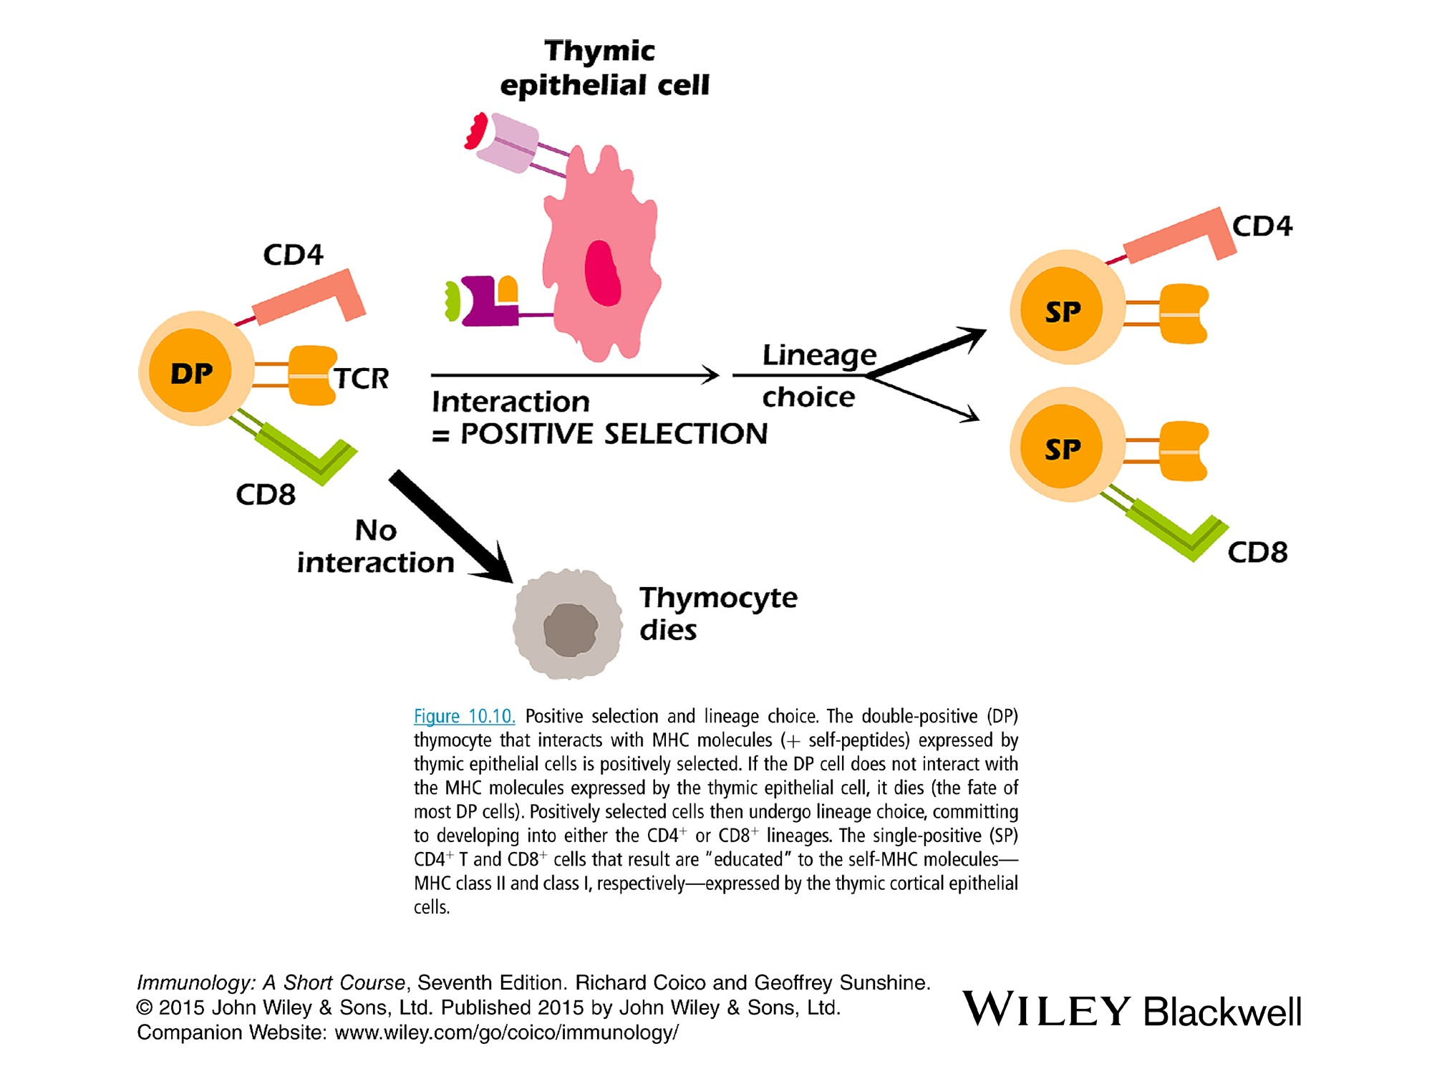

Slide 26
Negative selection
Self-reactive cells die
Occurs when dp cell interact with dendritic cells in the medulla.
A DP cell that reacts with too high affinity to the combination of MHC and self peptide is deleted by apoptosis.
A DP cell that does not react or reacts with very weak affinity to MHC-self peptide survive
Negative selection prevents self-reactive T cells which is the critical feature of central tolerance

Slide 27
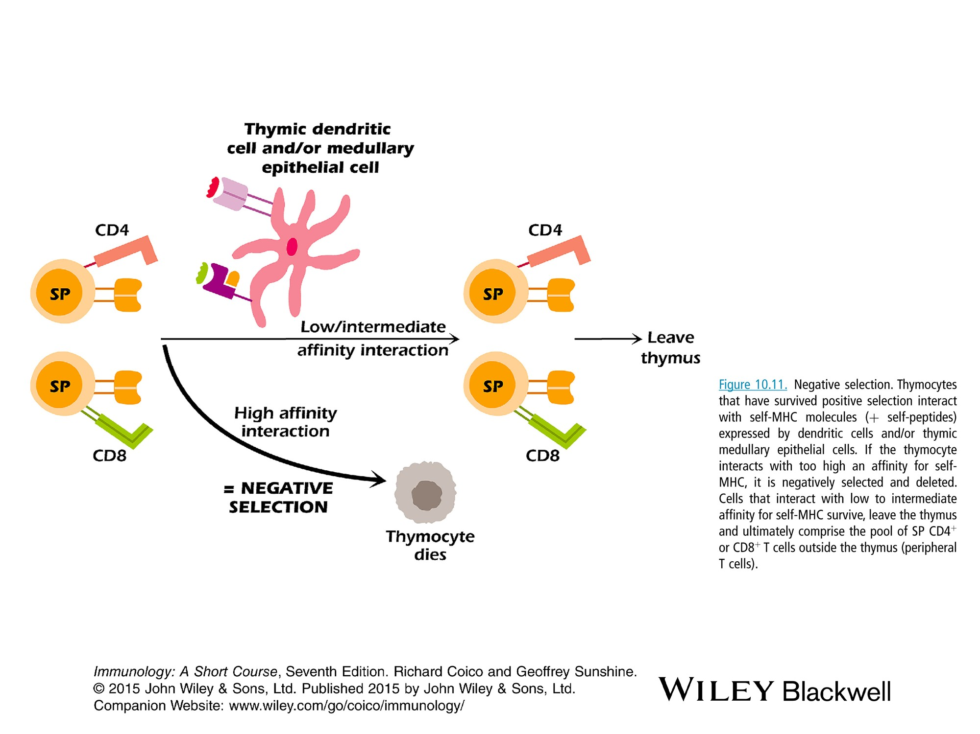

Slide 28
How do we develop self-tolerance to molecules normally found outside the thymus
Some self molecules normally synthesized outside the thymus including thyroglobulin (thyroid), insulin (the pancreas) and myelin basic protein (CNS) are expressed by thymic epithelial cells in the medulla
The product of the auotoimmune regulator (AIRE) gene expressed by thymic epithelial cells plays a role in negative selection
The AIRE gene product codes for a protein that controls the expression of self- molecules in the thymus.
If the AIRE gene is impaired, an autoimmune polyendocrinopathy-candidiasis ectodermal dystrophy syndrome (APECED) in which multiple endocrine organs are targeted

Slide 29
Single positive cells
Mature T cells
DP T cells that survive negative selection, down-regulate expression of either CD4 or CD8 resulting in sp T cells in the medulla
SP T cells leave the thymus via blood to secondary lymphoid organs where they may encounter the Ag.
Naïve state without encountering Ag need signals including IL-7 to keep them alive

Slide 30
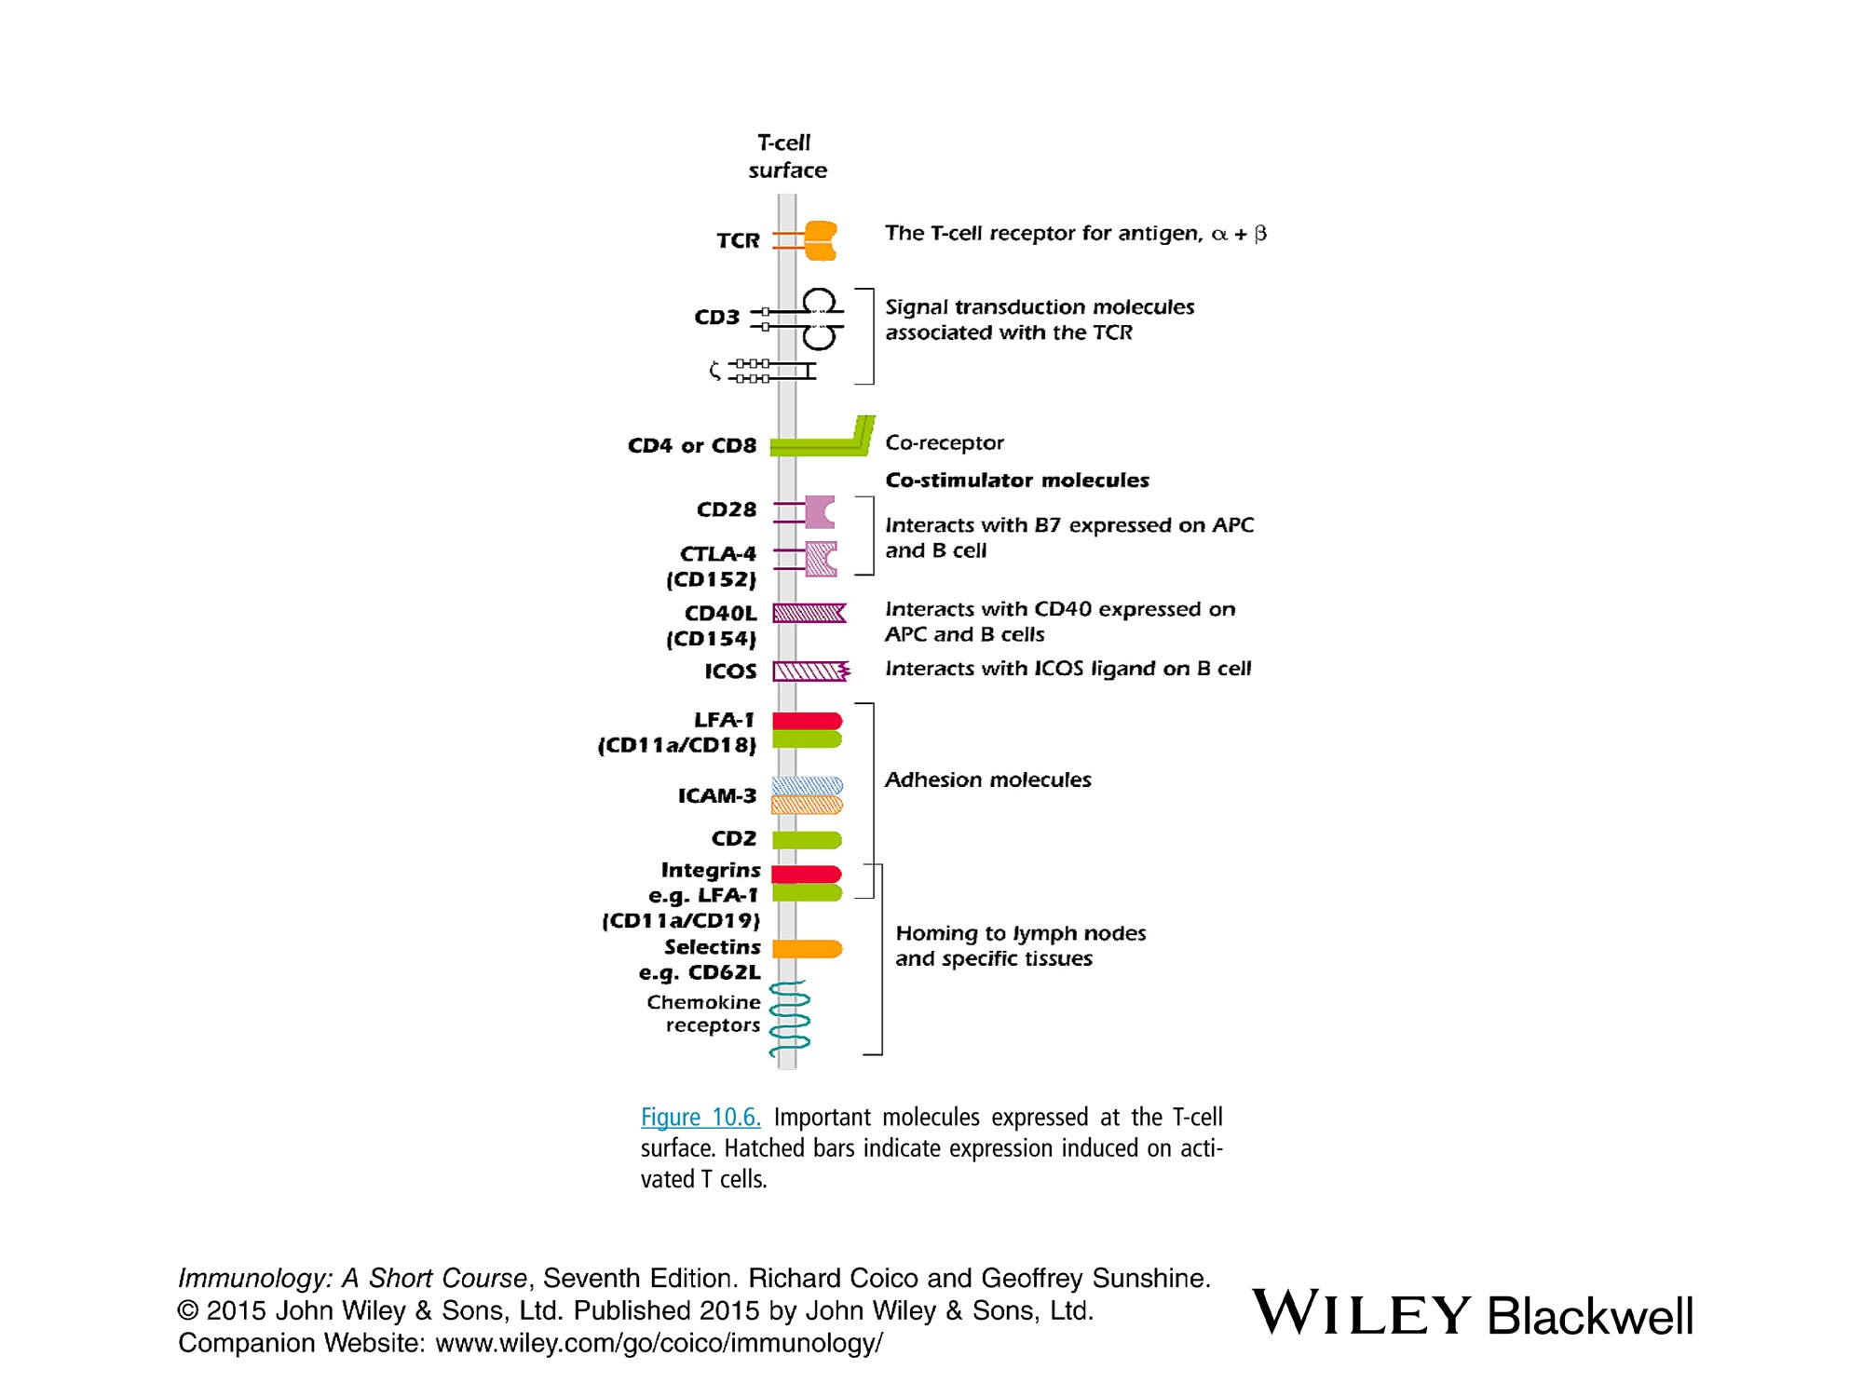

Slide 31
Characteristics of mature SP T cells
1. self-MHC restricted due to positive selection. T cells respond to an Ag only when associated with the MHC molecules
2. self-tolerant due to negative selection. Thus mature CD4 or CD8 T cells do not respond to self components.
The Developing T cell in thymus :
positive selection: self-MHC + self-peptide
negative selection: self-MHC + Nonself peptide
How does the same TCR respond to both self and nonself peptides?
The most likely explanation is that a single MHC molecule may bind different peptides

Slide 32
Other molecules expressed on T cell surface
1. Costimulatory molecules
-CD28 of T interact with B7 on APC: necessary for IL-2 synthesis
-CD40L of T cells interact with CD40 of APC
-ICOS of T cells interact with ICOSL on APC
CTLA4 a molecule related to CD28, expressed on activated T cells and interact with B7 molecules for negative signaling to activated T cells (regulatory step)
2. Molecules involved in Adhesion:
-LFA-1 lym function Ag interact with ICAM expressed on endothelial cells and APC
-CD2: expressed on all mature T cells

Slide 33
3. Molecules involved in homing
Homing the preferential entry of different types of lymphocytes into different tissues). Naïve T cells has the following molecules:
Naïve T cells, like naïve B cells, circulate through lymph nodes and other secondary lymphoid organs (naive lym are not normally found in tissues where an individual is likely to be exposed to pathogen).
Entry of naïve lym to L. nodes is mediated by the expression of the same set of adhesion molecules and chemokine receptors expressed by naïve B cells.
- L-selectin for entry to peripheral L.nodes and integrin for L.nodes in the mucoa. These adhesion molecules bind to glycoproteins known as ‘vascular addressins’ which are expressed on high endothelial venules
-CCR7 the chemokine receptor which bind the chemokine expressed by the high endothelial venules

Slide 34
ϒδ Cells
Most mammalian T cells use αβTCR but minor population expresses distinct 2-chain ϒδ TCR in association with CD3.
they Lack the CD4 and CD8 coreceptor and not MHC restricted!
ϒδ cells are found predominately at mucosal surfaces analogous to B-1 cells.
They provide the first line of defense against invading pathogens. They produce IFN-ϒ and have cytotoxic effect.
ϒδ Cells respond to phospholipids and other non-protein molecules phosphoantigens and heat shock protein.
Limited combination of Vϒ and Vδ gene segments.
ϒδ -knockout mice have a higher incidence of skin cancers induced by carcinogens, including methylcolanthrene (MCA).

Slide 35
NK cells
Develop in the thymus from the same bone marrow precursor that gives rise to the T cell lineage.
Splits off at DN stage before TCR genes start to rearrange.
Involved in the early phase of i.r. and considered part of innate immunity that kill viral-infected cells and tumor cells.
NK cells express CD16 and CD56 that may be use to distinguish them from other cell types.

Slide 36
NKT Cells
Small subset of T cells (1% of blood mononuclear cells), express both a TCR and NK1.1 (mouse) or CD16 (human) characteristic of NK cells.
Have features of both the innate and adaptive immune defenses
Respond to glycolipid Ags presented by CD1d rather than MHC molecules.
Regulate the function of other sets of T cells and have key roles in regulating autoimmunity, cancer and infection.
Most NKT cells use only one type of TCR Vα gene and a limited number of Vβ, their TCR is referred as semi-invariant.

Slide 37
T_{reg} cells
A subset of CD4+ T cells, approximately 10% of CD4 cells.
Express CD25 and the transcription factor foxp3.
Most T_{reg} cells develop in the thymus but some develop outside the thymus.
Survived negative selection and are autoreactive that they recognize self peptide and self MHC.
It has been shown that Tregs are able to inhibit other types of T cell proliferation and cytokine production and play a critical role in preventing autoimmunity.

